Slide 1
Software quality prediction using ensemble method in software projects.
Data Mining Project of
Second Year B.Tech CSE Second Year B.Tech CSE Second Year IDD CSE
Sanchit Tyagi Rishabh Rakheja Shikhar Sharma
18075053 18075050 18074016

Slide 2
About our Work
In our work, the aim is to develop an effective model which can be used for quality software predictions and bug detection. We will use various data mining techniques to achieve this.
We have collected the software metrics from open source repositories, did processing of the metrics and provided the assessment using statistical methods and other data mining techniques.
The most essential aspect being our structured methodology and the powerful feature reduction techniques and other pre-processing techniques that have been applied before applying the actual techniques.
Why maintaining software quality is essential:
Quality issues costs money to fix. Fixing an issue later in the development is much more expensive.
Bugs in a software can be hazardous to the system .
Buggy softwares do not last long in the marketplace.

Slide 3
About Datasets…
We conducted research in the field of data mining to find datasets on which papers have already been published. Also we used some other major datasets from open source repositories.
The datasets used are-
NASA Dataset
Eclipse Dataset
Elastic-Search Dataset
Android Dataset
A short summary about details of these datasets is present in the next slide.

Slide 4
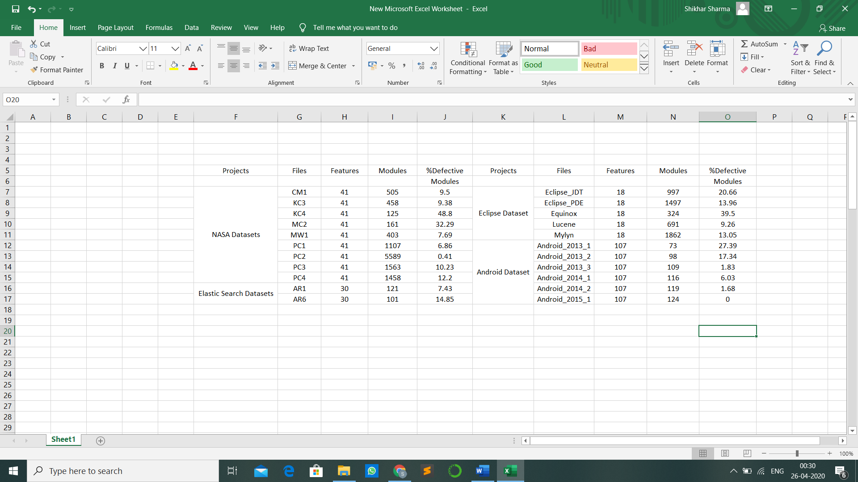
Here the features refer to the columns and the Module refer to each row present in the dataset file.

Slide 5
Workflow
Cleaning the Data:
After obtaining our datasets from their repositories, we have performed the necessary cleaning action on the them. There were some features in our datasets which had some missing values. It was necessary to deal with these missing values before doing anything. So, one efficient way we found out was to replace all the missing values in a column by the mean of all other values in that column.
The datasets were huge in size, and there some column which had all values in it exactly same. These columns were therefore removed without affecting our results.

Slide 6
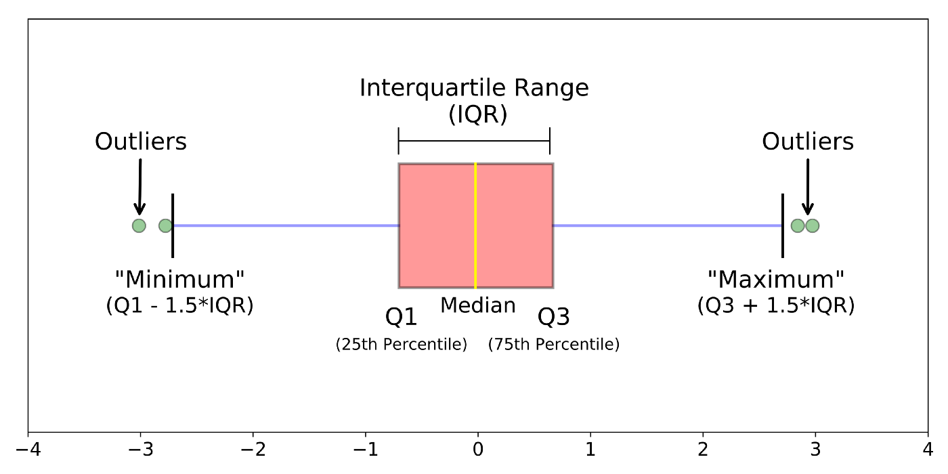
Detecting Outliers:
Detecting the outliers is our next step. We have used the method of IQR (Interquartile Range). The first and the third quartile (Q1, Q3) are calculated. An outlier is then a data point x_{i} that lies outside the interquartile range. These outliers are then removed.
There is no definite number of rows to be removed, so we started by removing one row, the one which is farthest away from the interquartile range, and applied the three feature selection techniques on it independently. Now, we continued deleting rows in this order and updating the results for different feature selection techniques after each step. To ensure that there is not a great loss of data, we have set an upper limit as to the number of removed rows.

Slide 7
Feature Reduction:
SelectKBest (SKB)
We have given score to each feature based on chi2 function. Now at this point we were not sure that how many columns should we select to obtain best results and without loss of much data. So, we started with removing one column and found out the result for each classifier.Then one by one we removed the columns with least score and simultaneously updated the results for each classifier. To avoid data loss, we have set a maximum limit for number of column removals.
2. Principal Component Analysis (PCA)
PCA was the advanced feature reduction method which helped us in achieving results beyond our expectation. It combines our input variables in a specific way, then we can drop the least important variables and retain the important ones.
3.Variance Technique:
In the VAR technique, the statistical concept of variance was applied here to find the distribution of values. It finds the variance for each feature and the one with least variance contributes the least.
Standardisation is a technique wherein we convert the values of each feature such that mean is zero and standard deviation is 1. At every point after removing the columns we have standardised the data.

Slide 8
Classification Models
We used the following most commonly used yet most effective machine learning models: -
Naïve Bayes
A Naive Bayes Classifier is a supervised machine-learning algorithm that uses the Bayes’ Theorem, which assumes that features are statistically independent. The theorem relies on the naive assumption that input variables are independent of each other.
Support Vector Machine
An SVM model is basically a representation of different classes in a hyperplane in multidimensional space. The hyperplane will be generated in an iterative manner by SVM so that the error can be minimized. The goal of SVM is to divide the datasets into classes to find a maximum marginal hyperplane (MMH).

Slide 9
K-Nearest Neighbours
The KNN algorithm assumes that similar things exist in close proximity. In other words, similar things are near to each other. An object is classified by a plurality vote of its neighbours, with the object being assigned to the class most common among its k nearest neighbours.
Ensemble Classifiers
Ensemble methods are learning algorithms that construct a set of classifiers and then classify new data points by taking a weighted vote of their predictions. It generates various base classifiers from which a new classifier is derived which performs better than any constituent classifier.
Sequential Parallel
Dependence between base learners Independence between base learners
Known as Boosting methods Known as Bagging methods

Slide 10
Random Forest (Parallel Classifier)
Random Forests grows many classification trees. To classify a new object from an input vector, put the input vector down each of the trees in the forest. Each tree gives a classification, and we say the tree "votes" for that class. The forest chooses the classification having the most votes (over all the trees in the forest).
Adaboost (Sequential Classifier)
AdaBoost assigns a “weight” to each training example. Examples with higher weights are more likely to be included in the training set, and vice versa. After training a classifier, AdaBoost increases the weight on the misclassified examples so that these examples will make up a larger part of the next classifiers training set, and hopefully the next classifier trained will perform better on them.
Majority Voting
Every model makes a prediction (votes) for each test instance and the final output prediction is the one that receives more than half of the votes.

Slide 11
Results
We have used Accuracy and F-score as the 2 performance indicators for our model.
Accuracy: The accuracy of a classifier is given as the percentage of total correct predictions divided by the total number of instances.
F-score- It is a performance metric which includes both precision and recall.F-score is defined as harmonic mean of precision and recall i.e
F-score= 2*(Recall*Precision)/(Recall+Precision).
The bar graphs show the average accuracy and average F-score that has been calculated for our datasets
Majority Voting is the technique that have worked best for the NASA dataset.
Random Forest has given best results for Eclipse projects.
The techniques that have performed best for Android and Elastic Projects are Random Forest and Majority Voting. We see that in general the best technique has been Majority Voting.

Slide 12
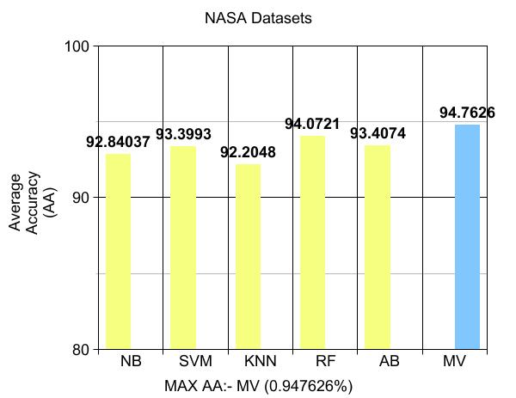
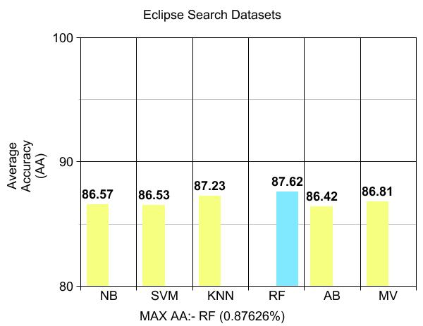
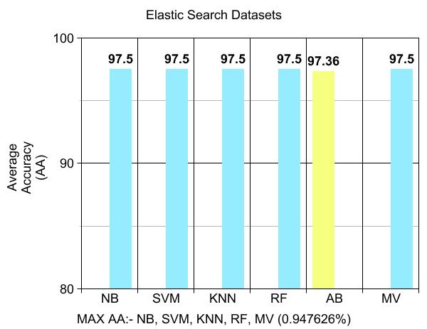
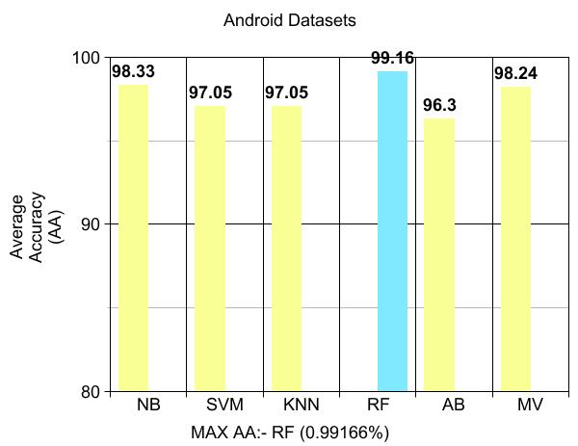
Accuracy Results

Slide 13
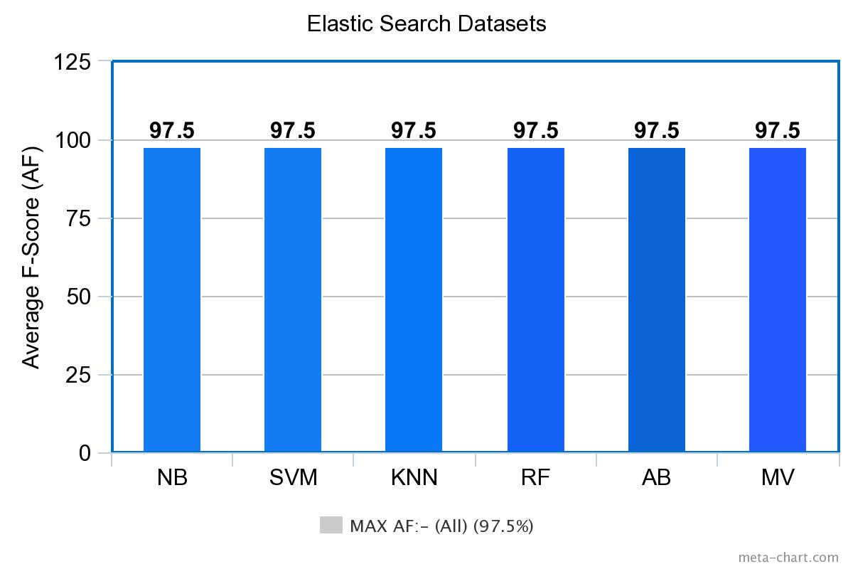
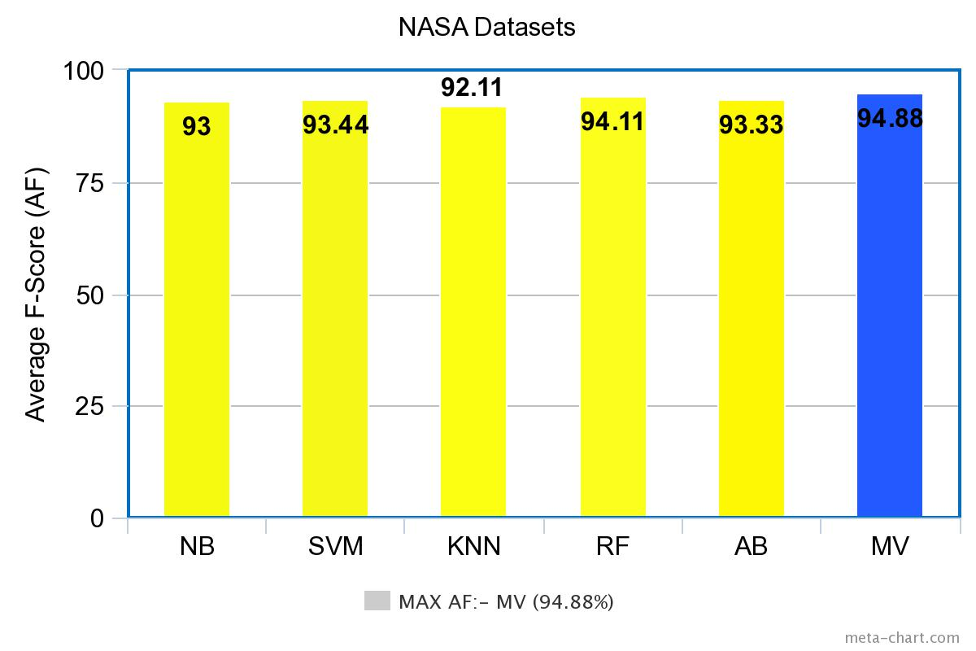
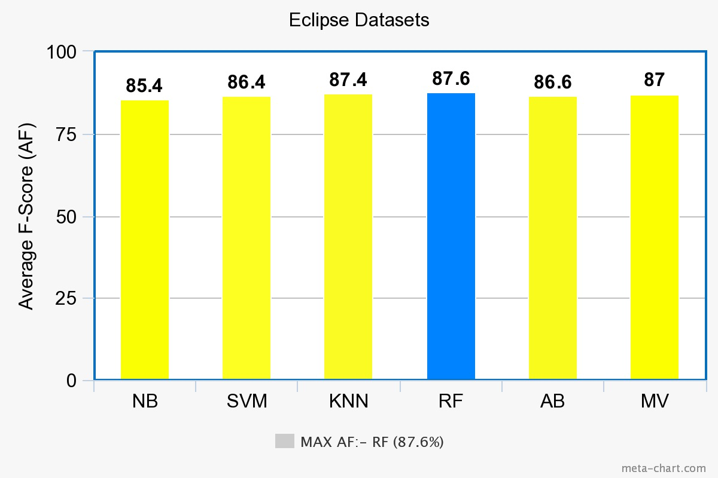
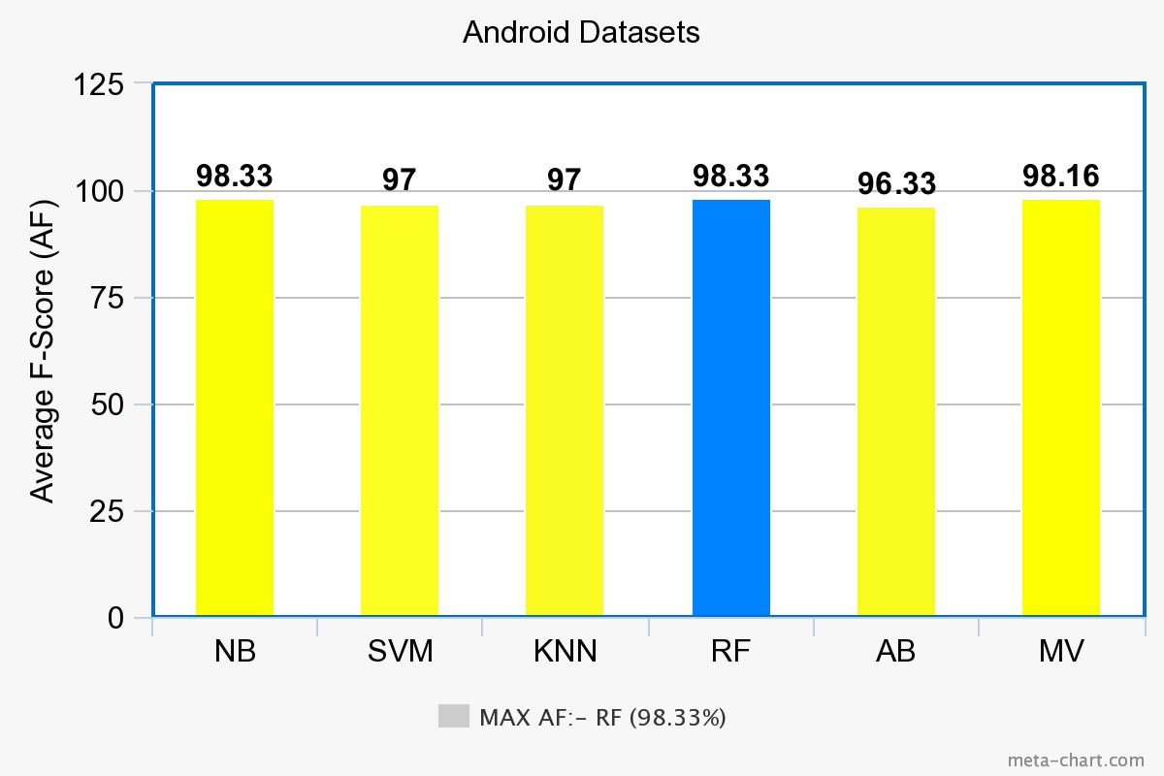
F-score Results

Slide 14
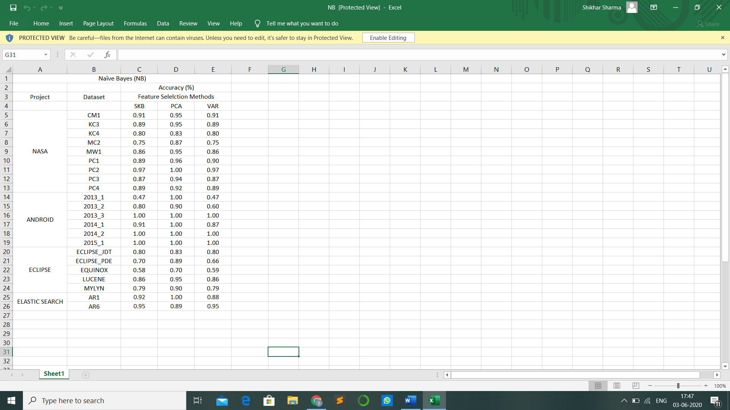

Below tables show the results of accuracy for all our datasets on all classifiers using all feature selection techniques.

Slide 15
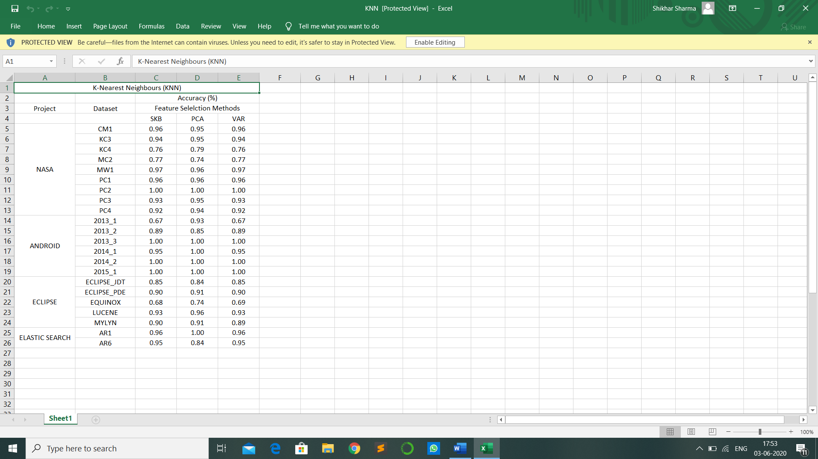


Slide 16



Slide 17
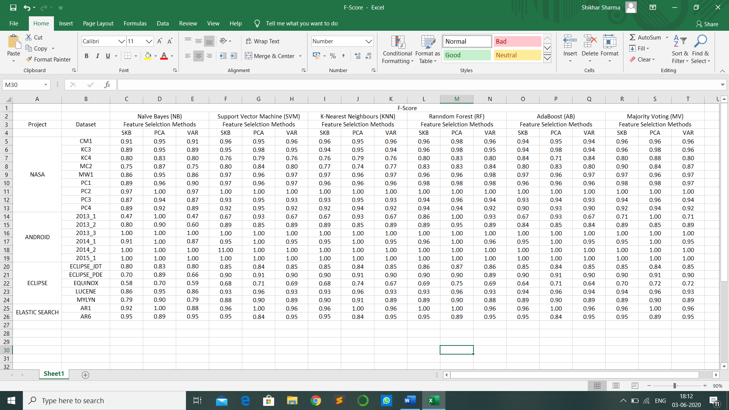
Below table show the complete results of F-score for all our datasets on all classifiers using all feature selection techniques

Slide 18
Conclusion
In our study we have tried to find a way to detect bugs in software and improve software quality by applying some techniques on some open source projects.
We have used currently existing techniques and performance criteria to come to a conclusion. Unlike the previous studies, we have widened our field of study and applied more concrete methods which have yielded better results.
We conclude from our work that Random Forest and Majority Voting have performed the best results over all datasets.
We have also tried to show how data mining can constitute a great deal in predicting software quality.

Slide 19
Thank You

